Slide 1
Grant Funding
FINDING – APPLYING - WINNING

Slide 2
AGENDA
Grant Basics
Grant Writing Process
Sources of support for the grant process
Examples

Slide 3
Grant Basics

Slide 4
Grants versus Loans
Grants are a funding source to help on-farm projects
Unlike loans, grants don’t have to be repaid
Notes:
Picture: Stock images (Word)

Slide 5
What are competitive grant programs?
Competitive application for limited funds
Communicated through NOFAs, RFPs, or RFAs
Different types for source and geography
Entities are required to apply and compete for limited funds, with funding agencies determining eligibility and allocation based on outlined criteria
Agencies announce and detail these opportunities through Notices of Funds Availability (NOFA), Request for Proposals or Applications (RFP / RFA)
These programs can be public or private and come from different geographic tiers (federal, regional, state or local)
Notes:
Image: Original
IPCC, 2023: Sections. In: Climate Change 2023: Synthesis Report. Contribution of Working Groups I, II and III to the Sixth Assessment Report of the Intergovernmental Panel on Climate Change [Core Writing Team, H. Lee and J. Romero (eds.)]. IPCC, Geneva, Switzerland, pp. 35-115, doi: 10.59327/IPCC/AR6-9789291691647

Slide 6
Two primary types of competitive grants in agriculture
Cost-share Programs
Proposal-based
Agency covers a percentage of project costs at set rates for set practices, depending on the practice type
Applicant covers the remainder of the project costs
The rates and supported project types are dependent on each state or your local office
Applicants need to submit detailed proposals outlining their project goals, budget, and expected outcomes, with funding awarded based on merit and alignment with the agency’s priorities
Funding amount: applicants apply for a specific dollar amount based on planned activities. There are usually no set rates for practices

Slide 7
Grants help fund a range of projects to help your farm
Adopt sustainable practices
Increase sales
Improve efficiency
Diversify business

Slide 8
Examples of proposal-based grant programs
Rural Energy for America Program (REAP) | Federal program that supports renewable energy systems (e.g., solar, wind, digesters) and energy efficiency projects (e.g., improved lighting, equipment, grain dryer upgrades)
Regional Business Builder Programs | Regional hubs that provide up to $100k for projects that boost business viability and strengthen regional food systems (e.g., business planning, staff time, equipment, marketing, and supply chain coordination or innovation)
Dairy Business Innovation Centers | Regional hubs that focuses on diversifying dairy markets, supporting processing and marketing innovation, and strengthening regional milk production through business consulting, product development, and modernization efforts
Value-Added Producer Grants (VAPG) | Federal program that supports value-added business with business planning (e.g., feasibility studies) up to $75k and working capital (e.g., processing costs, marketing, select inventory expenses & salaries) up to $250k
Sustainable Agriculture Research & Education (SARE) | Federal program that support farmer-driven innovation and research in sustainable agriculture practices (e.g., soil health improvement, cover cropping, integrated pest management). Requires a partner (e.g., university).

Slide 9
Grant Writing Process

Slide 10
Typical grant process
1
2
3
4
5
6
Define goals
Business goals & corresponding projects for next year
Find grants
Identify grants for those projects
Determine grant fit
Eligible, competitive and ready
Apply for grant
Narrative, budget, letters of support, etc.
Review & submit
Quality check and correct submission format
Follow up reporting
Post-award requirements

Slide 11
Define goals
1
Start early (8-12 months before you need funding)
Think about your long-term goals and corresponding projects:
What outcomes do I want to achieve over the next few years?
What projects will help me get there this year?
What investments will I need to make to complete those projects?
Optional: Work with an extension office, business planner, advisor to draft a business plan for these goals. Business plans are often required or helped supplementary documents to grant applications
Tip: Many grants won’t fund projects already started or completed —apply before starting a project

Slide 12
Identify grants: Sources to find opportunities
2
Monthly newsletters
Extension office
Local offices
DMI database
Check if your co-op, check-off group, banking partner, etc. sends grant updates
Check the nearest university with an extension office to find out more on their resources
Speak with your local NRCS or Soil and Water Conservation District offices
Database updated with details on upcoming dairy-specific public grants
Tip: Make sure to check across different geographic tiers (federal, regional, state and local) and different types (public or private)

Slide 13
Identify grants: Sources to find opportunities
2
Some grants allow stacking (combining federal, state, and local funds) while others cannot
Check in the Request for Proposal (RFP) document or contact the funding agency to understand your ability to apply for multiple grants for the same project
Example: A Washington farmer combined federal, regional, and state grants to cover new ice-cream business’ costs

Slide 14
Determine grant fit: Eligibility
3
Are you Eligible?
Applicant
Project
Am I the eligible applicant type?
For example, some grants might be for non-profits or for public entities (e.g., municipalities) rather than for individual producers or for-profit businesses
Does the end goal of my project align with the state grant goals?
Do my corresponding budget items fall under eligible activities?
Am I in the eligible geography?
Does my business meet size requirements?
(e.g., years in business, revenue, number of employees, profile of employees)

Slide 15
Determine grant fit: Competitiveness
3
Are you Competitive?
After determining you and your project are eligible, you need to make sure you have a high likelihood of getting the grant so it’s worth your time and energy to apply. Even though you might be technically eligible, you might not be a good fit for the grant goals
Check the rubric: Most grants have a scoring rubric. Estimate how you or your project would score and check if the funding agency is willing to share typical scores that get awarded and not awarded
Contact the agency: Pick up the phone or email the agency to learn more what projects or applicants are prioritized for this grant

Slide 16
Determine grant fit: Readiness (I/III)
3
If you’re eligible and competitive, make sure you have sufficient time to complete the requirements of the grant
Will I be responsible for covering project expenses up front?
Many grants are reimbursement grants. Reimbursement grants send you your award only after you spent the money (e.g., whether it’s your own or a loan) on the pre-approved expenses. You submit an invoice and only then will the grant agency will reimburse you. Therefore, you need a plan to pay for the expenses before getting reimbursed. In some cases, you can negotiate with the agency to get funding upfront, particularly if you’re historically underserved.
Do I need to provide matching funds with the grant?
Some grants require matching funds—your contribution to the project through cash, credit, loans, or in-kind support. For example, a $100,000 project with a 25% grant means you’ll receive $25,000 and must show you can cover the remaining $75,000.
Note: In-kind contributions are non-monetary contributions like hours work, donated goods, space, or transportation. Your bank can fill out a matching funds letter that states you a) have cash in your accounts, b) have an approved line of credit, or c) have an approved loan for the matching funds amount.

Slide 17
Determine grant fit: Readiness (II/III)
3
If you’re eligible and competitive, make sure you have sufficient time to complete the requirements of the grant
Do I need to apply with a partner or provide letters of support?
Most grants require or recommend you provide letters of support. A letter of support is a document from an external individual or organization endorsing a project, program, or organization. It strengthens a grant proposal by highlighting the project’s significance, potential impact, and the writer’s connection to it. A strong letter is persuasive, well-written, and includes examples of how the project benefits others. Make sure to give these stakeholders advance notice to write you a quality letter of support.
Do I need a business plan?
Some grants require or recommend you supplement your application with a business plan. A business plan can take significant time to put together, so take at least 2 months ahead of grant deadlines to find any support to create the business plan if needed, gather data needed for the business plan, and organize financials with your accountant. If you’re not getting support, use software tools like Liveplan to aid you in putting it together.

Slide 18
Determine grant fit: Readiness (II/III)
3
If you’re eligible and competitive, make sure you have sufficient time to complete the requirements of the grant
Do I need quotes with my budget?
Some grants require vendor quotes for budget justification, typically for equipment and installation expenses. Work with vendors at least 1 month in advance to receive quotes.
Do I need to register in SAM.gov?
SAM.gov is the System for Award Management. Many federal grants require you to register your business entity to receive a Unique Entity Identifier (UEI) number. This allows you to receive the grant funding should you be awarded.
Receiving and activating your UEI in the system can take 10 days business days, so make sure to complete this process in advance of the grant application.
Do I need to apply with a partner?
Some grants require or recommend you apply with partners (e.g., vendor, community organization). Make sure to give these stakeholders advance notice to participate in the grant and clarify their required inputs for the application.

Slide 19
Apply for the grant: Typical processes
4
COST-SHARE
Less of an application heavy lift, but rather direct work with your local office
Reach out to your local NRCS or Soil & Water Conservation District office. With the office, you can find out about upcoming deadlines to participate in the cost-share programs, understand local funding priorities and cost-share levels, and exact steps to receive cost-share approval.
Find your NRCS office here: https://www.nrcs.usda.gov/state-offices
PROPOSAL-BASED
Often requires significant time and effort, with limited interaction with funding agency during application process
The subsequent slides will go into more details, but the high level process is as follows: set your project goals and define their relationship to the grant priorities and to your longer-term business goals, create a corresponding budget that aligns with those project goals, find contacts for letters of support, and draft narrative.
Focus of
next slides

Slide 20
Apply for the proposal-based grant: Goals
4
Align project goals to the big picture
Take the long-term goals that you set in Step 1 and define specific projects that will help achieve those goals
Example: Installing a milking robot can free up labor for business expansion for the next 10+ years
Then, map which of these projects match with the grant priorities like in Step 3
Throughout the application, keep tying these individual projects to the long-term goals and grant priorities

Slide 21
Apply for the proposal-based grant: Budget
4
Putting together a budget
Based on your defined projects, finalize a corresponding budget that makes your project a reality
Budgets can include in-direct and direct costs
Indirect costs: Expenses like utilities and salaries that support multiple projects but can't be tied to a single one
Direct costs: Expenses tied to the specific project tied to the grant application
Information to include in budget document
Budget line item
Requested grant amount
Source for that line item value (e.g., quote, estimate, online research)
Typical budget categories to include
Equipment
Supplies
Marketing
Personnel / labor
Consultants

Slide 22
Apply for the proposal-based grant: Narrative
4
The narrative should always be built on your project goals, the connection between those goals and the grant and your long-term business goals, and the corresponding budget items that allow you to complete those goals. Once you have the building blocks, you should be able to put together a cohesive narrative.
To put together a successful narrative:
Be concise - Data is far more valuable than fluff. Use data to backup your points. For example, if you want to grow sales of a value-added product in your local area, include data that shows the local population size and target demographic population, state or local data on consumer purchases historically, your historic revenue that product, etc.
Be specific - Include information and data specific to your project. Instead of sharing national dairy trends, talk specifically about trends within your state or county if you’re focusing on selling a product locally.
Be consistent - Your overall application should tell a cohesive story about your business, your long-term goals, and how your specific project goals, work plan and expenses will contribute to your long-term business goals.
Fulfill the requirements - Make sure you answer all the questions and follow the word / character count limits.

Slide 23
Review and submit grant
5
Review your grant:
Does it have any typos or grammatical errors?
Does it meet the word or character limits?
Does it include all required elements?
Did I address all points in the rubric (when included)?
Submit grant:
Check to see the preferred submission format (e.g., online portal, email with 1 document, etc.)
Tip: Make sure you get a confirmation that they received your grant submission

Slide 24
Post-award follow ups
6
Some grants require follow ups after you’ve been notified of the award
Immediate follow ups
Signing a grant agreement, providing tax documents
Longer-term follow ups
6-month, 12-month reporting on the progress of your project and use of the grant

Slide 25
Sources of support for the grant process

Slide 26
Sources of support for the grant process
Extension office
Non-profits
Grant writers
Focus of next slides

Slide 27
Working with a grant writer: Overview
When should I contact one?
How to evaluate one?
How do fees work?*
Ask trusted network for referrals (e.g., check-off, extension program)
Make sure to evaluate their transparency in their fee structure, process and success rate
Up-front fee: regardless of success
Success fee:% of award amount; typically higher than flat fee
Mix of both: small upfront + success fee
After figuring out business goals and projects for the year, a grant writer can help you find grants, determine fit and ultimately put together applications
c
Tip: Make sure your grant writer follows and clearly communicates with you similar guidelines shown in this presentation!

Slide 28
Working with a grant writer: Key Questions
Process
What is your typical process?
What are the steps and how long will it take?
What exactly will you support me with: Grant finding? Grant writing? Post-award reporting?
Communication
How will you communicate with me and how often?
What is your typical response time?
Data
What information do you need from me?
How do I know the data I send you is secure?
Who will you be sharing me data to?
Payment
What is your fee structure?
When are the fees due (e.g., up front, upon grant submission, after award notification)?

Slide 29
Working with a grant writer: Process
During the process:
The grant writer will set a work plan and timeline for putting together the parts of the grant application.
They will then work with you to define your project goals and their connection to the grant priorities and your longer-term business goals.
They can draft letters of support and matching fund letter templates.
They will write the narrative. Before sending to you for final review, they will review and compile the grant application. They can often submit the grant on your behalf if you add them as collaborators.
After submitting the grant:
You both should keep each other updated if you hear anything from the funding agency about the results of the grant.
c
Tip: Clarify up front with them if the grant writer will help with any follow ups after you receive the award. Some grant writers will not help with this part of the process.

Slide 30
Examples of Grant Funding

Slide 31
Example One
THE FARM
1600 milking cow dairy in North Dakota, shipping milk to local and regional processors
LONG TERM GOAL
Support a 15% increase in milk production, scale capacity to meet rising demand from partners, and save energy costs with more efficient machinery.
PROJECT FOCUS
This project expanded milk cooling and storage on their dairy farm while improving sustainability through a heat recovery system that reduces propane use and boosts efficiency.
GRANT NAME
North Dakota Agriculture Diversification & Development Fund
GRANT AWARD AND BUDGET
$380k requested and awarded out of $580k budget

Slide 32
Example Two
THE FARM
Iowa dairy farmer with experience in value-added products with range of cheese products
LONG TERM GOAL
With a growing artisan cheese line, increased staffing, and a focus on sanitation and safety, they wanted to support sales growth and customer satisfaction in a competitive market.
PROJECT FOCUS
This project aims to enhance creamery operations by investing in key equipment like a hydraulic hoop cutter and upgraded storage facilities to improve efficiency, product quality, and reduce waste.
GRANT NAME
Dairy Business Builder
GRANT AWARD AND BUDGET
$60k requested and awarded out of $80k budget

Slide 33
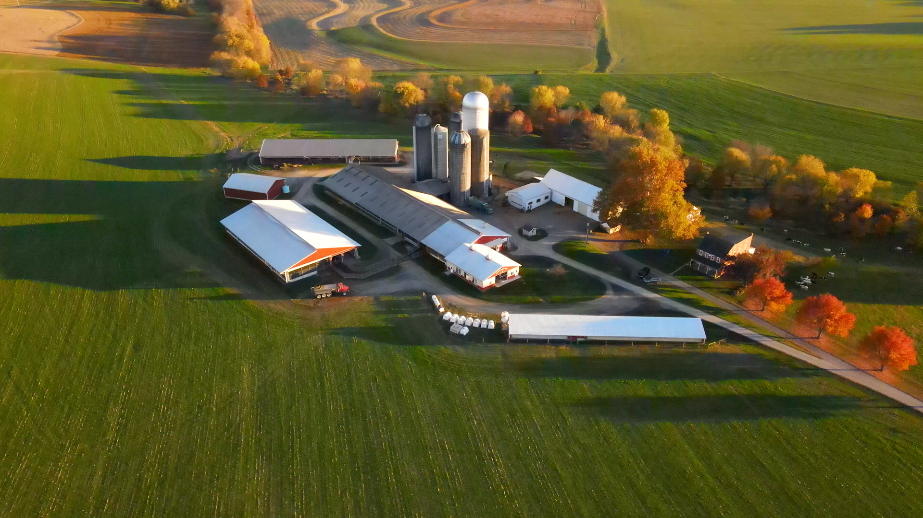
Grants can work for you
Start early, stay organized, and apply with confidence!
In collaboration with Lasso Solutions, Inc.

Slide 34
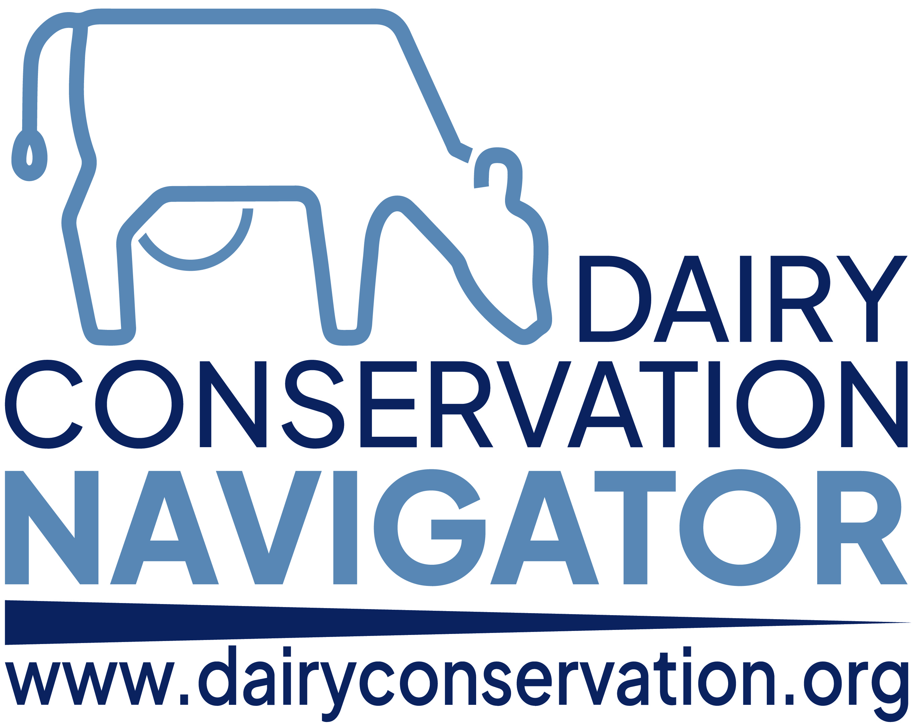
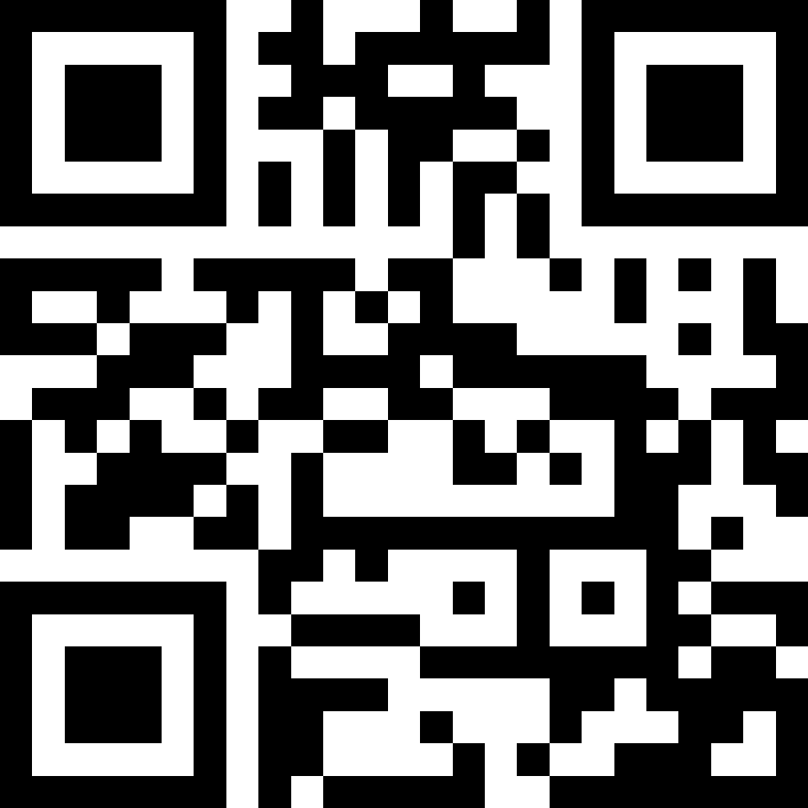
Funded and Developed by Dairy Management Inc. (DMI)

