Slide 1
Feed Management: Enhancing Sustainability by Reducing Feed Loss

Slide 2
OBJECTIVES
Demonstrate the relationship between feed management and sustainability.
Explain concepts related to feed production, storage, and management.
Present feed management opportunities to reduce feed loss, preserve feed quality, and enhance the sustainability of dairy farms.
Note: Feed management differs across the country. There are regional variations in the types of forages grown, and the portion of forages and other feed ingredients that are home-grown or bought-in.

Slide 3
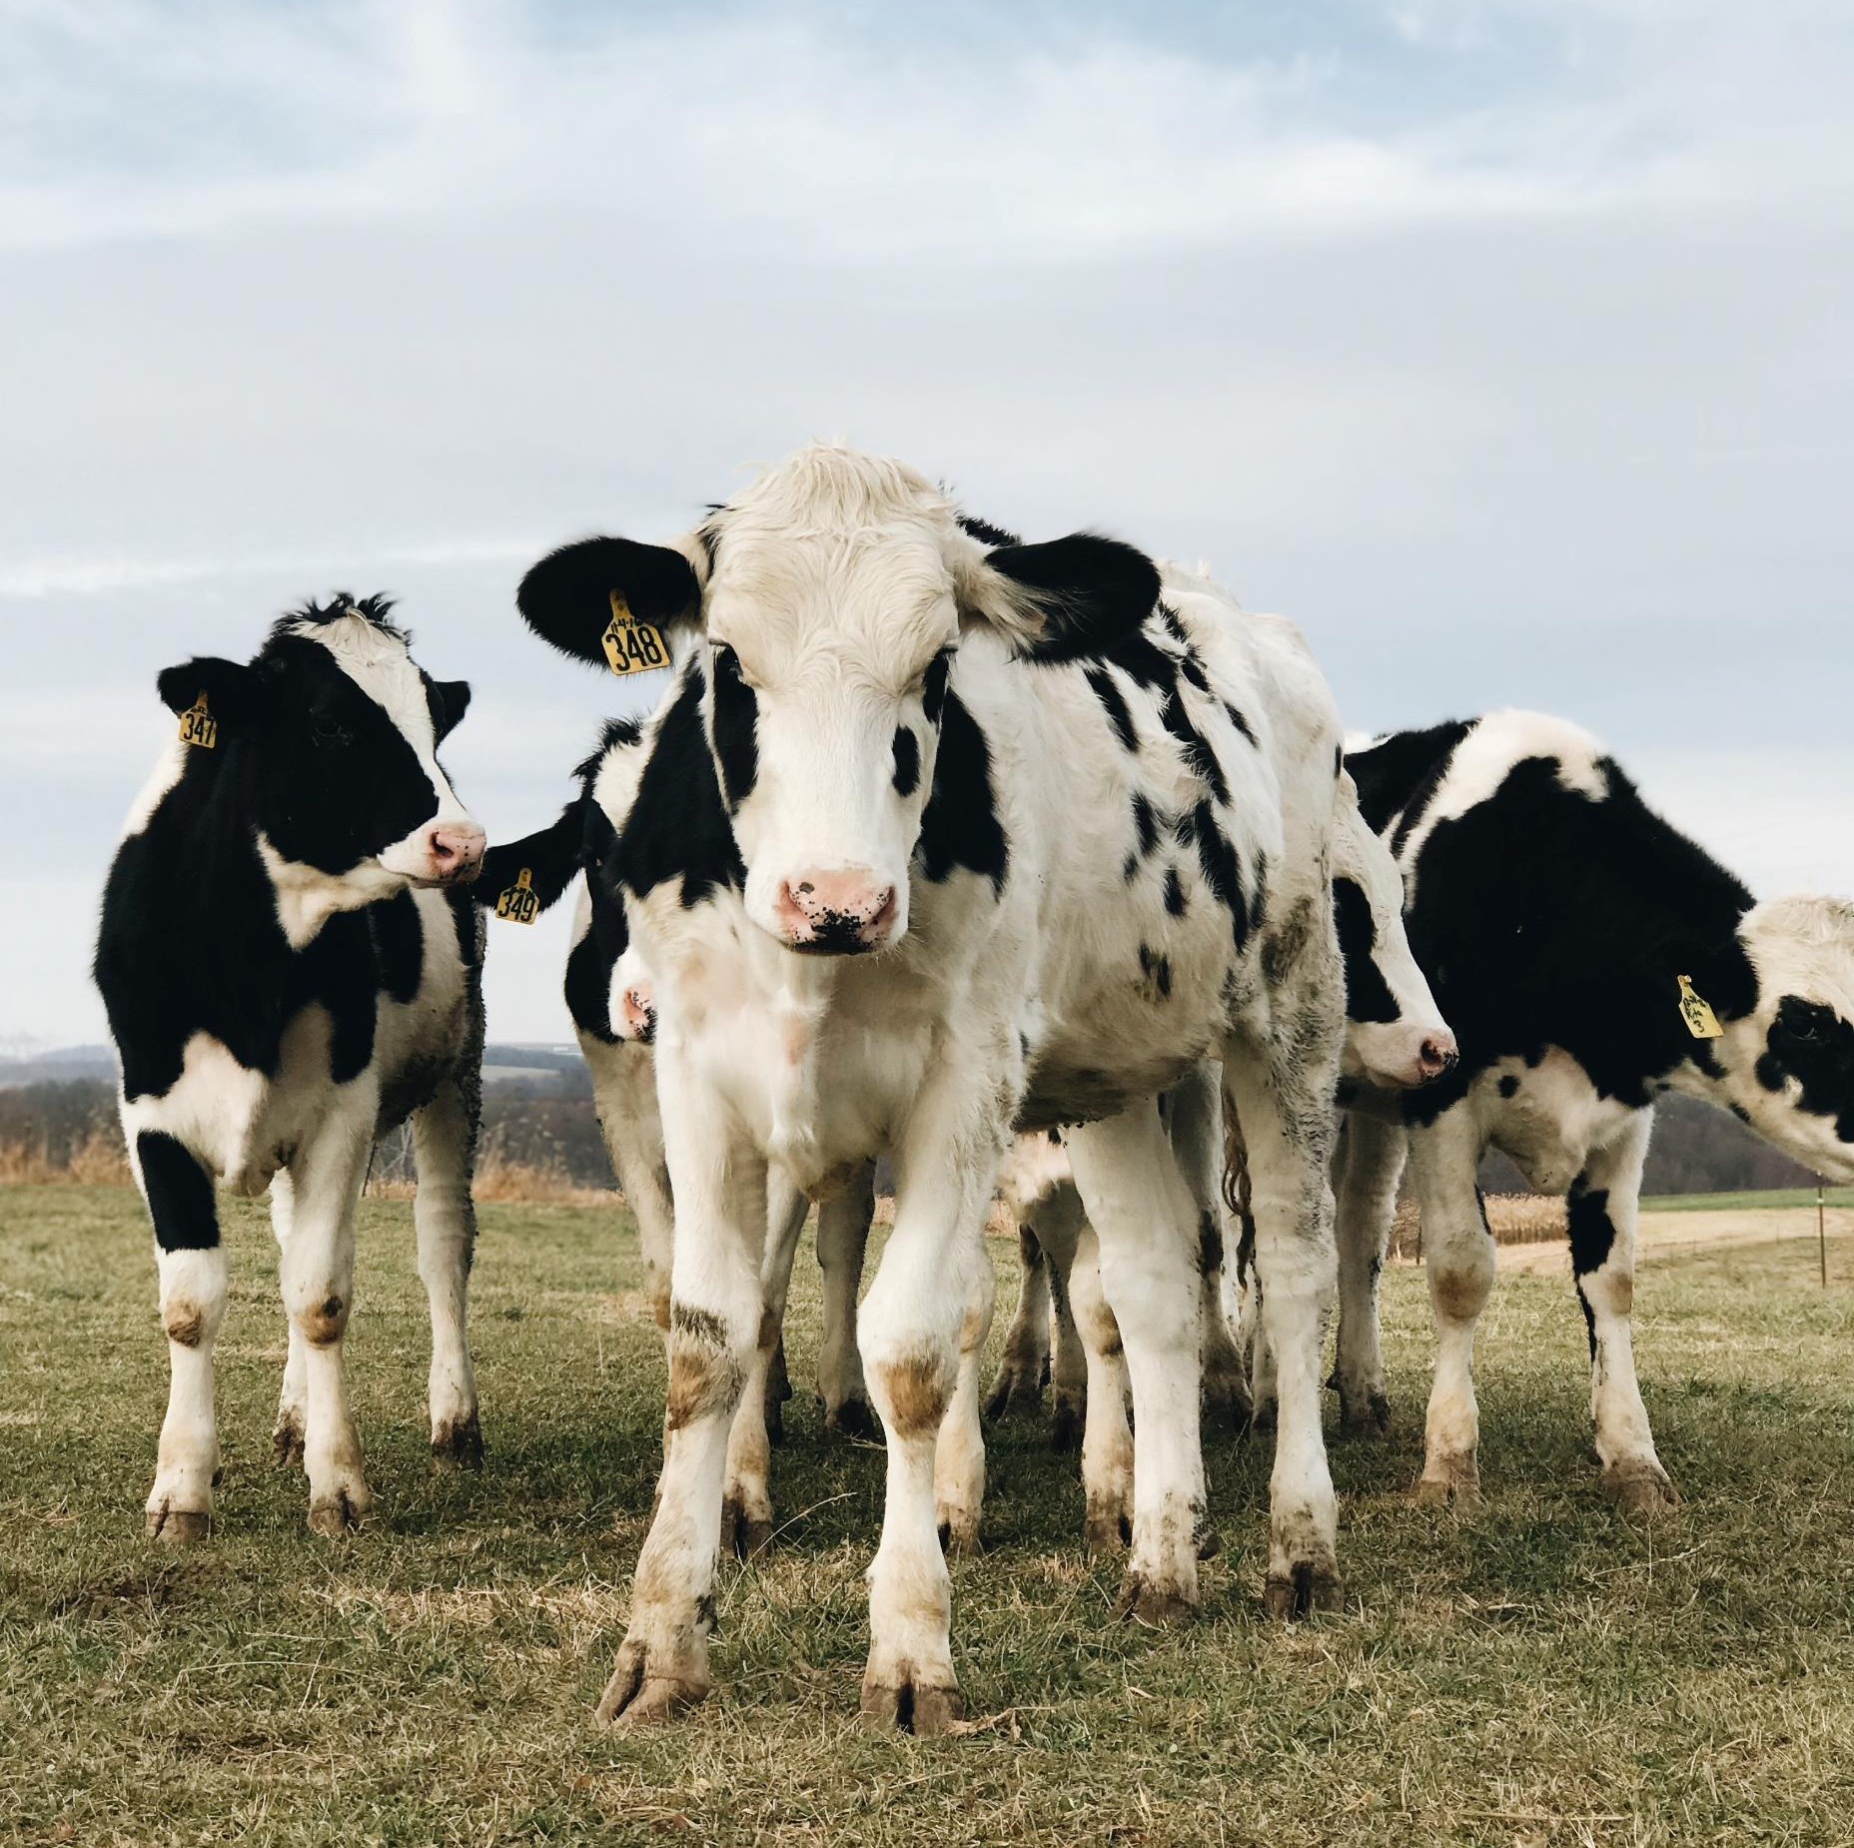
AGENDA
How is Feed Production Related to Sustainability?
Feed Shrink Basics
Shrink Impacts on Acreage Needed
Forage Quality
Managing Forage Quality and Feed Systems
Key Takeaways

Slide 4
How is Feed Production Related to Sustainability?

Slide 5
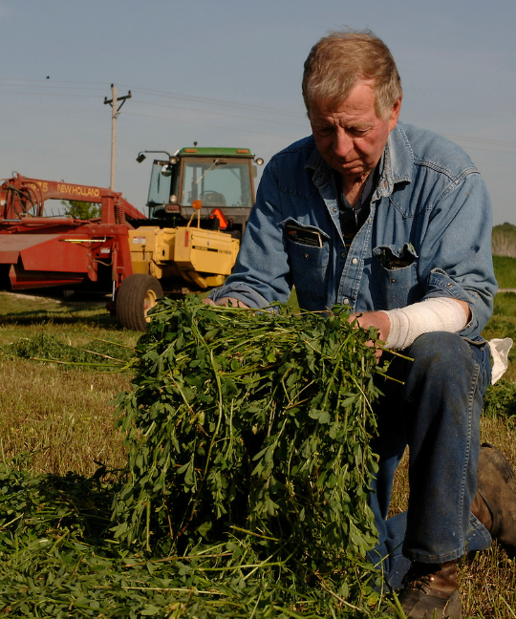
Feed Production and Sustainability
Feed production is resource-intensive
Requires significant inputs to grow, harvest, and purchase, such as:
Land
Labor
Equipment
Minimizing loss of feed (shrink) contributes to a sustainable farm by minimizing wasted resources
Notes:
https://dairy.photoshelter.com/galleries/C0000.P4WrHK5QIU/G0000ksZ07N98BFg/I0000kV2vG75I.QI/Connelly-1187-jpg

Slide 6
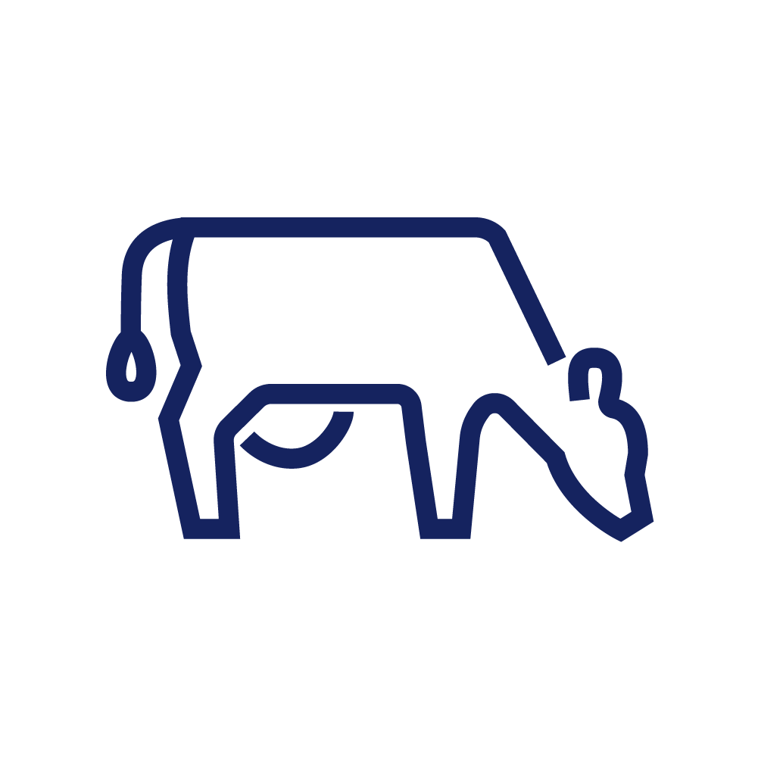
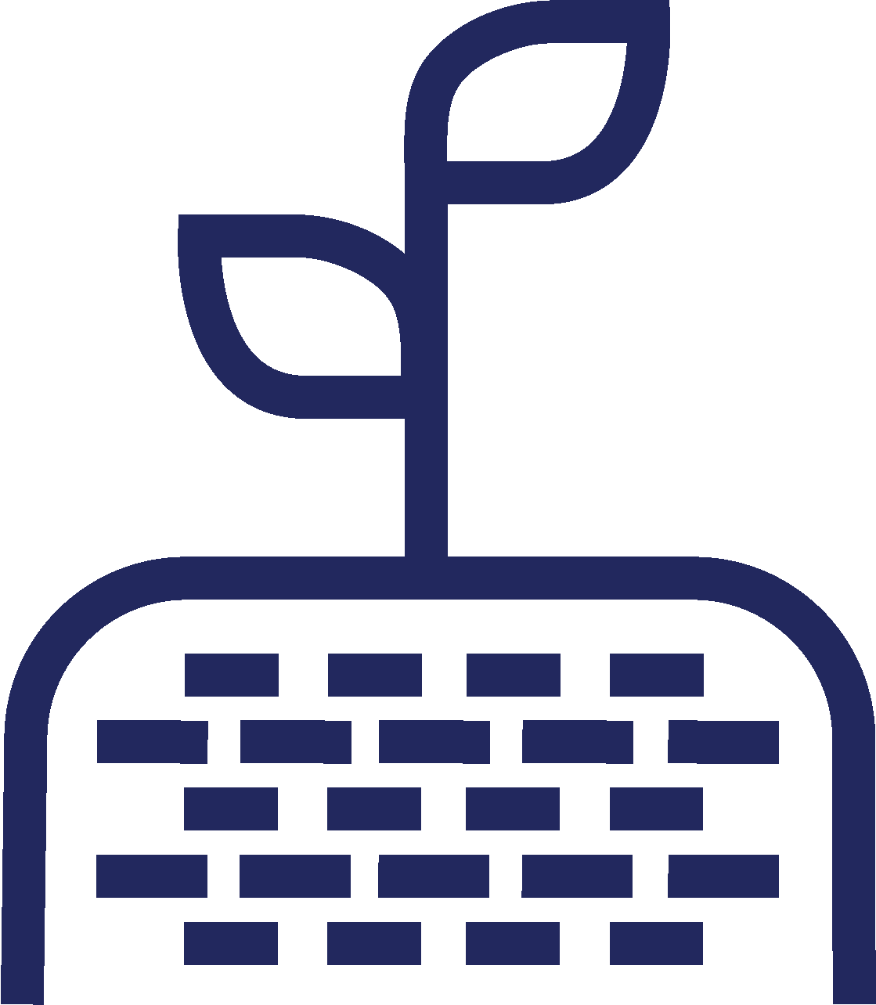
Feed Production and SUSTAINABILITY
Circular Economy of
Dairy Farms
Feed production is integrated into the circular economy of dairy farms
Forages grown on the farm are fed to cows and manure is used to fertilize fields
Crop rotation with perennials can enhance soil health and land sustainability
Healthy cows
Field fertilization
and crop rotation
Manure
management
Bowles et al. 2020. Long-Term Evidence Shows that Crop-Rotation Diversification Increases Agricultural Resilience to Adverse Growing Conditions in North America. One Earth. https://doi.org/10.1016/j.oneear.2020.02.007.
Notes:
Long-Term Evidence Shows that Crop-Rotation Diversification Increases Agricultural Resilience to Adverse Growing Conditions in North America

Slide 7
Feed Production and Sustainability
Feed Management's Impact on a
Farm's Environmental Footprint
1. | Animal health and production
2. | Enteric methane emissions
3. | Acres under cultivation for animal feed production
4. | Required feed purchases and trucking
5. | Potential impact on local waterways

Slide 8
Feed Shrink Basics

Slide 9
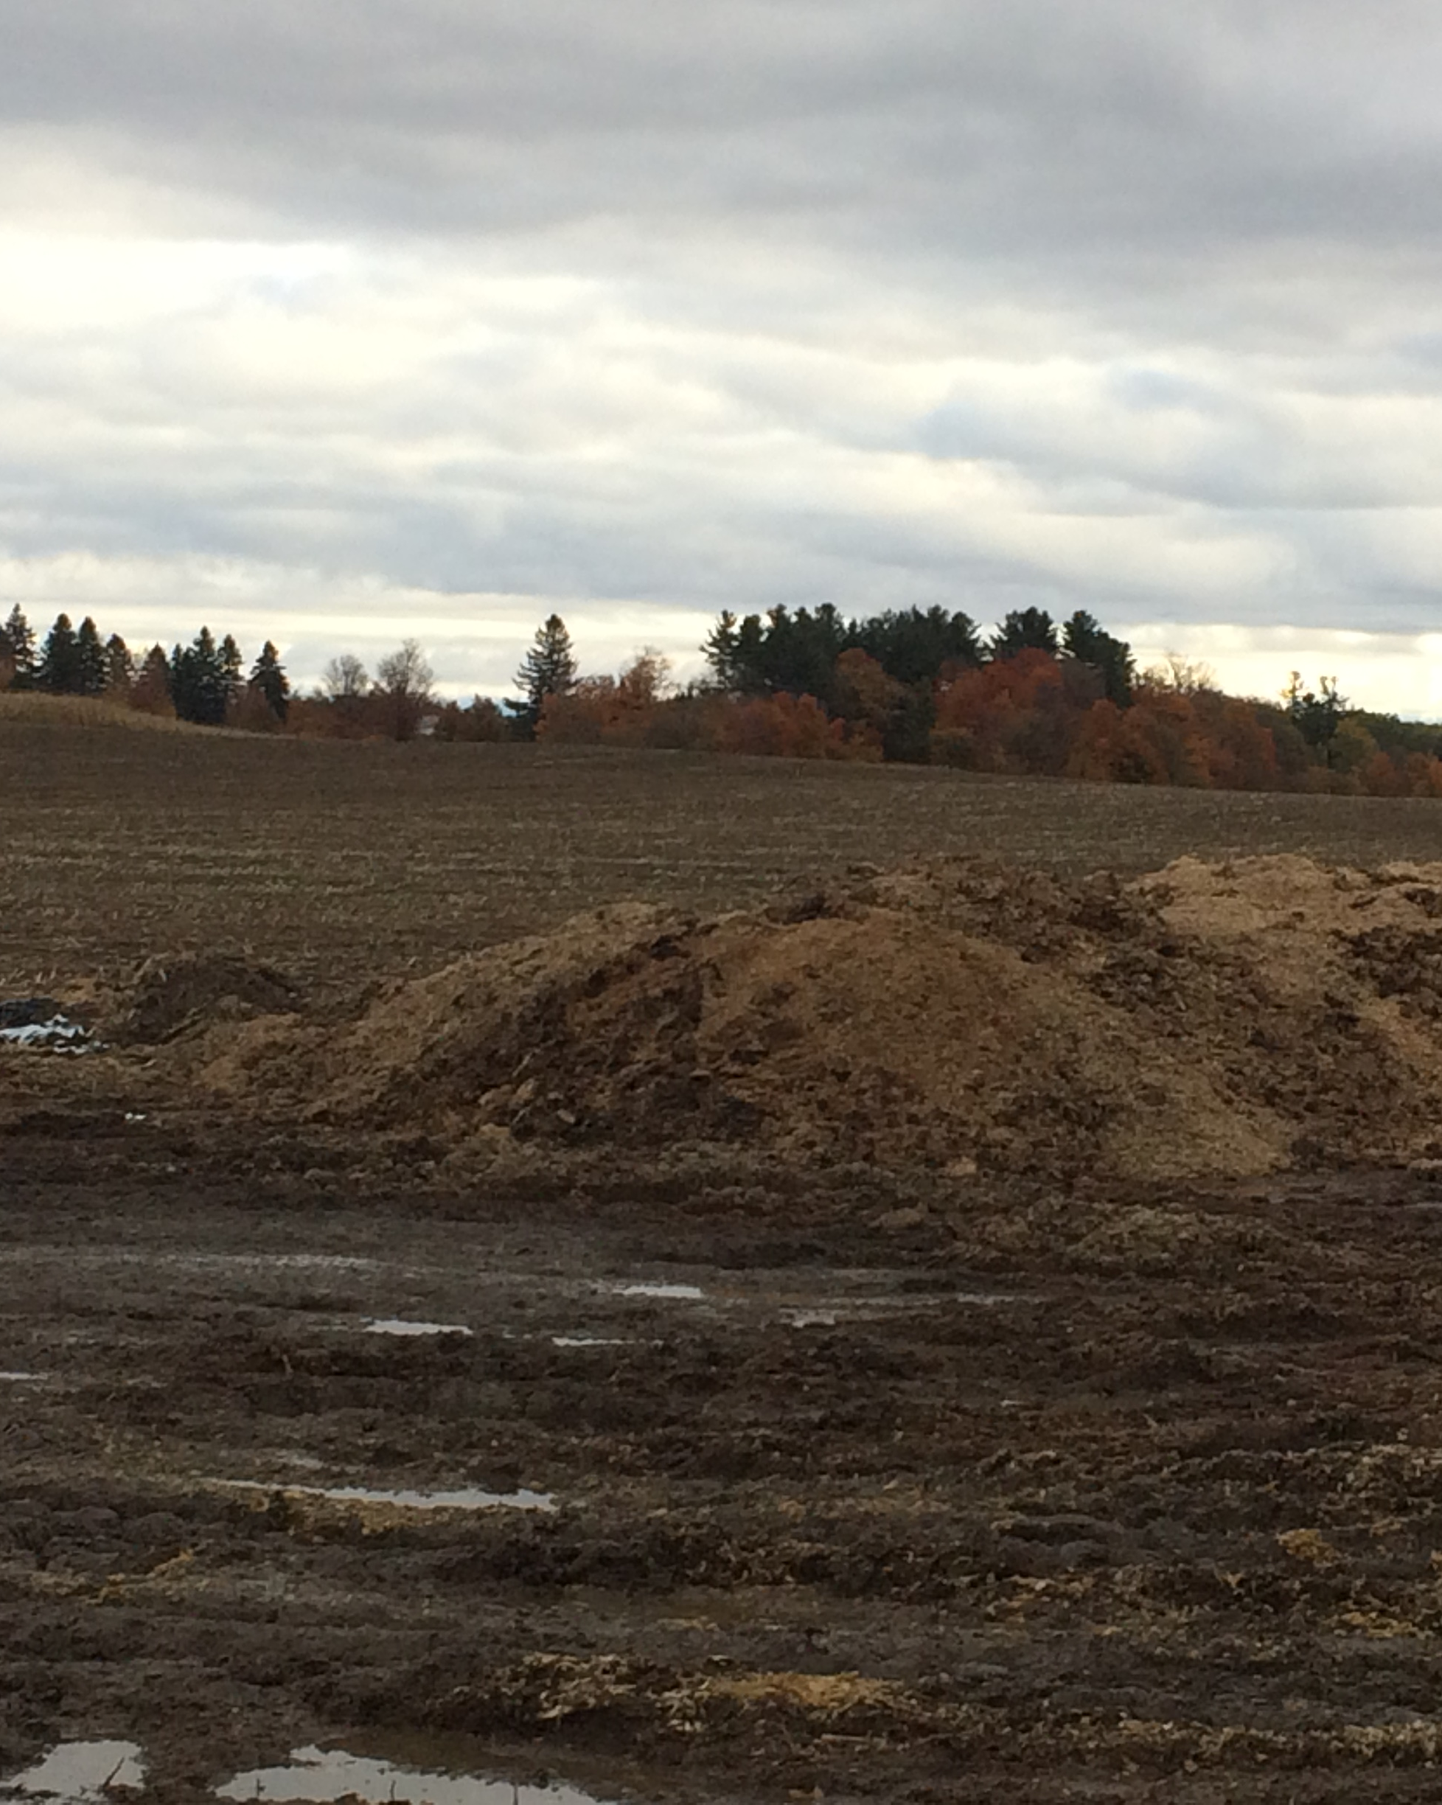
What is feed Shrink?
Shrink, or shrinkage, refers to the loss of feed that doesn’t have an economic return
It includes the direct loss of feed quantity and the indirect loss of feed quality
Shrink can happen during harvest, storage, handling, or feedout
Minimizing shrink and poor quality is essential to reduce resource use and costs
Notes:
Picture supplied by Joe Lawrence, Cornell Extension

Slide 10
What is feed Shrink?
Biological shrink refers to the loss that happens during fermentation. Biological shrink in fermented forages can be close to 10%.
A small percentage of biological shrink is inevitable as fermentation microbes consume a portion of the feed for energy
Shrink also includes avoidable causes like spoilage due harvest and transport losses, poor fermentation, rain, wind, and inaccuracy during feeding
Lawrence, 2023. Forage opportunities to combat rising costs. Progressive Dairy. https://hdl.handle.net/1813/112844
Notes:
Lawrence, 2023. Forage opportunities to combat rising costs. Progressive Dairy. https://hdl.handle.net/1813/112844
Shrink's impact on the acreage needed to support a herd can be calculated using the PRO-DAIRY Forage Acreage Needs Calculator

Slide 11
Shrink Impacts on Acreage Needed
Using the PRO-DAIRY Forage Acreage Needs Calculator

Slide 12
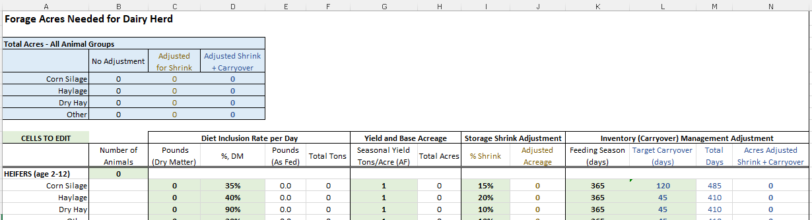
PRO-DAIRY Forage Acreage Needs Calculator Example
Example of a farm with the following inputs:
500 cows eating 20 lbs DM/cow/day of corn silage and 8 lbs DM/cow/day hay silage
Corn yield: 20 tons/acre (at 35% DM)
Hay yield: 9 tons/acre (at 38% DM)
Total tons corn silage needed to feed 500 cows for 365 days: 5214 tons
Total tons hay silage needed for 500 cows for 365 days: 1921 tons

Slide 13
PRO-DAIRY Forage Acreage Needs Calculator Example
Corn Silage
Acres of corn needed to secure this tonnage:
With good management 6-8% biological shrink + a few extra percent (generally considered a baseline of what is achievable): 287 acres
With additional +5% shrink from management (15% total shrink): 300 acres
Hay Silage
Acres of hay needed to secure this tonnage:
With good management 6-8% biological shrink + a few extra percent (generally considered a baseline of what is achievable): 235 acres
With additional +5% shrink from management (15% total shrink): 245 acres
Management choices causing an additional 5% shrink, results in 500-cow dairy needing to grow an additional 13 acres of corn and 10 acres of hay. That is 23 acres that is planted, maintained, and harvested but never used.

Slide 14
Forage Quality

Slide 15
What is High-Quality Forage and Why is it Important?
Lab Analysis
Protein
Starch
Feed Value
Stability
Toxins
Contaminants
Molds
Vitamins
Minerals
Fiber
Palatability
A high-quality forage:
Meets the nutritional needs of the animal
Balances the correct amount of fiber and digestibility
There are two components:
Lab analysis (nutritional components of the feed)
Feed value (overall quality of a feed)

Slide 16
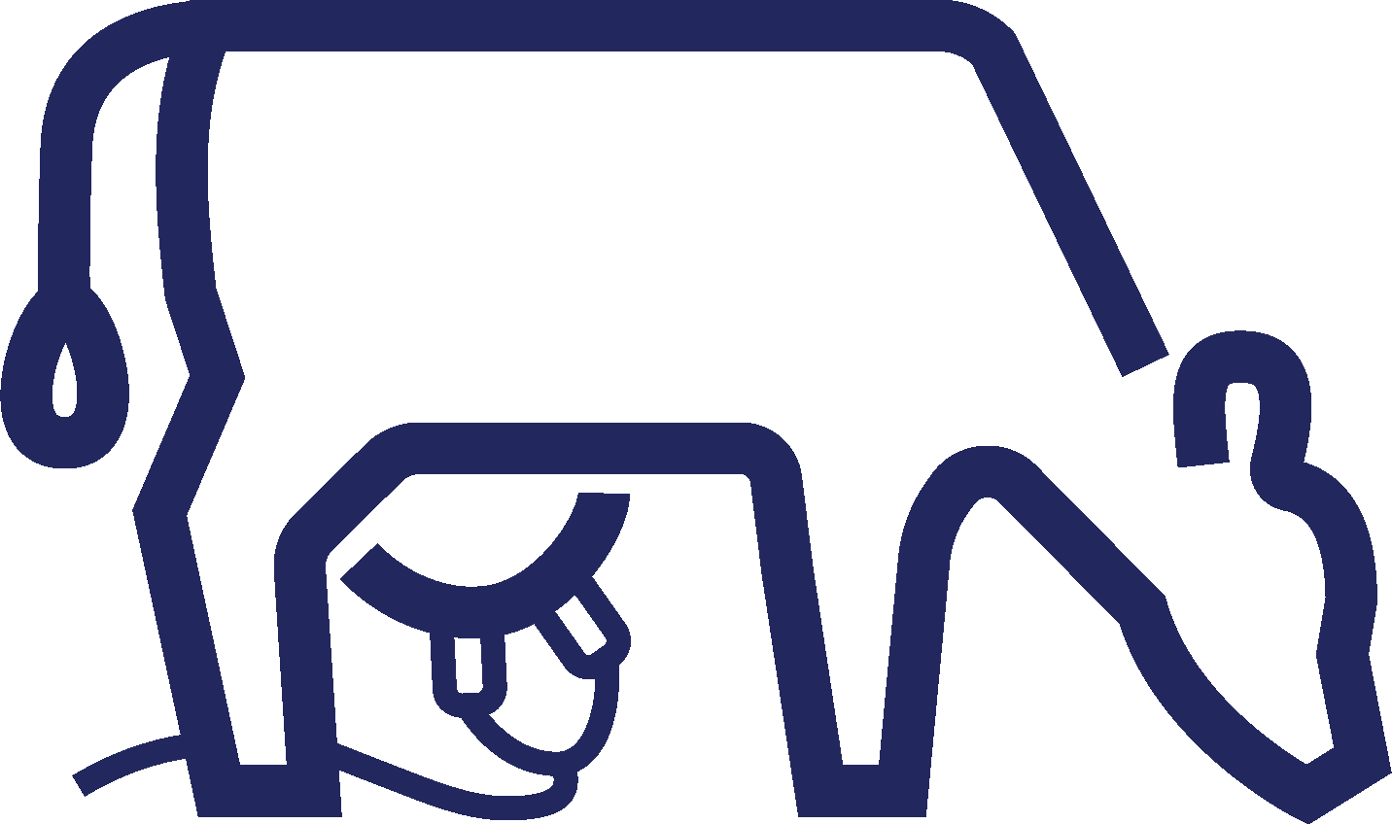
What is High Quality Forage and Why is it Important?
Forage quality is economically important for farms
Drives ration composition
Dictates the need to purchase additional feeds or supplements
High-quality forage is also critically important for cows to stay healthy and produce milk efficiently
Dairy farms can improve sustainability by preserving both
forage quantity and forage quality

Slide 17
Managing Forage Quality & Feed Systems

Slide 18
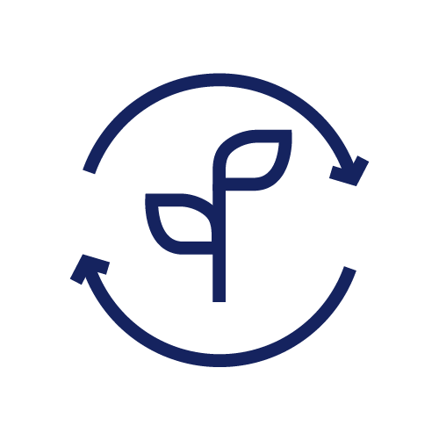
Feed Loss Reducing Opportunities
To reduce feed loss and enhance overall efficiency, we can focus on three key stages:
1. Forage Harvest
2. Forage Storage
3. Feed Systems & Feedout
Optimizing practices in these areas significantly improves forage quality and minimizes waste

Slide 19
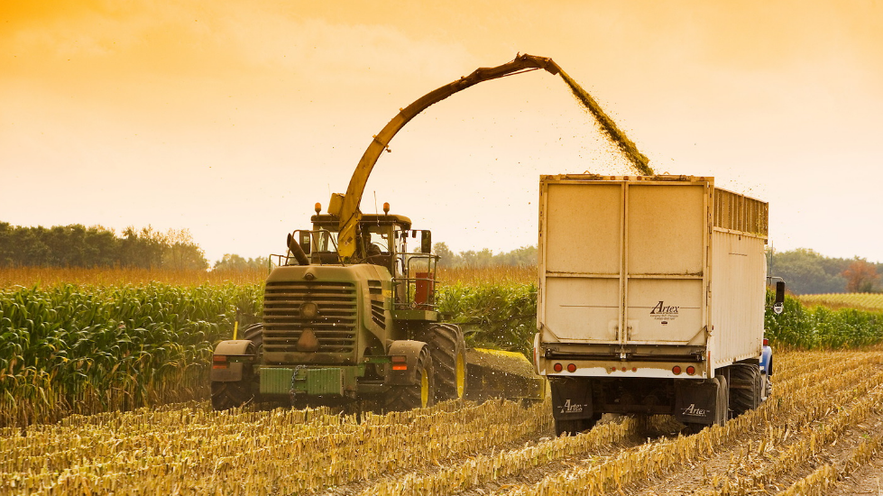
1. Forage Harvest
Plant Maturity
Timing is critical when it comes to harvesting forages
Harvest at the optimal stage of maturity to preserve feed nutrient content
Notes:
https://dairy.photoshelter.com/galleries/C0000.P4WrHK5QIU/G0000ksZ07N98BFg/I0000fBp_MBldl7g/Larson-021-jpg

Slide 20
1. Forage Harvest
Plant Maturity
Harvesting at the correct moisture content is essential to:
Facilitate fermentation
Minimize effluent
Prevent spoilage
Notes:
https://dairy.photoshelter.com/galleries/C0000.P4WrHK5QIU/G0000ksZ07N98BFg/I0000fBp_MBldl7g/Larson-021-jpg

Slide 21
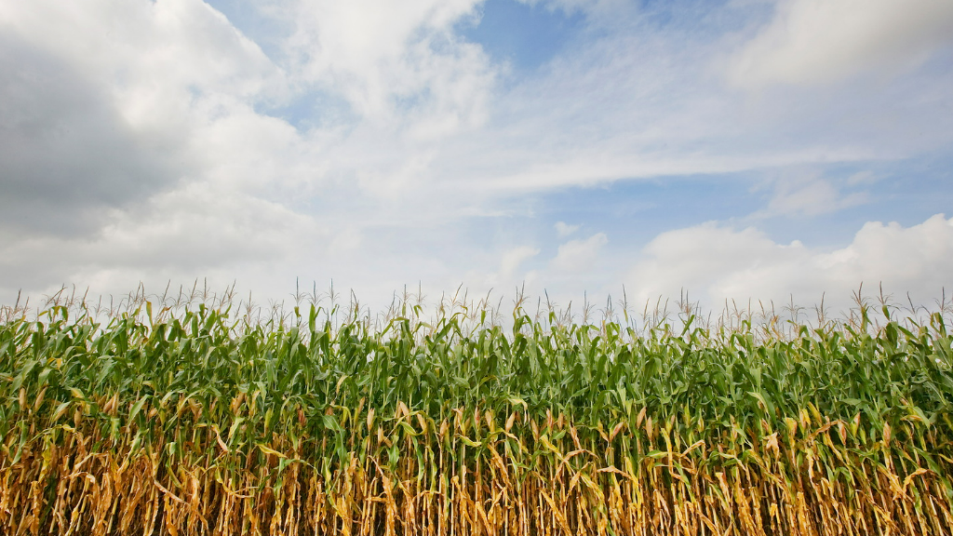
1. Forage Harvest
Processing of Forage
Cutting forage too long or too short can impact bunk packing and fermentation
Unprocessed corn kernels pass through into manure
It is important to maintain machines and not rush
Notes:
https://dairy.photoshelter.com/galleries/C0000.P4WrHK5QIU/G0000ksZ07N98BFg/I0000iHEtUBbykfc/Larson-026-jpg

Slide 22
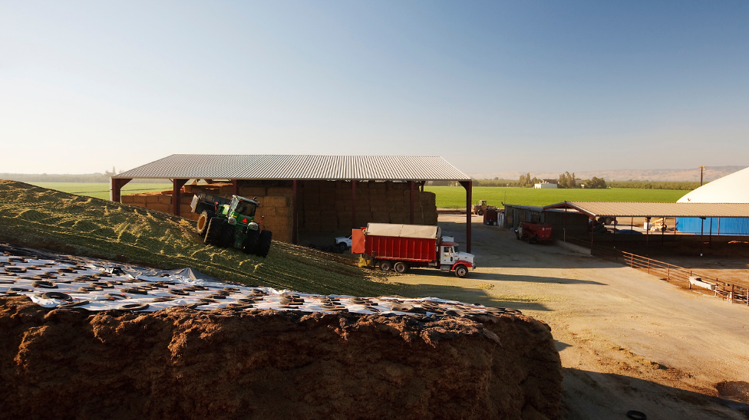
2. Forage Storage
Density
Forages must be compacted to the correct density to remove oxygen. This creates an anaerobic environment for fermentation.
Notes:
https://dairy.photoshelter.com/search/result/I0000t1MDnZKJRcU?terms=corn%20silage&

Slide 23
2. Forage Storage
Fermentation
Inoculants speed up fermentation and ensure the forage ferments evenly and remains stable. Inoculants must be distributed evenly.
Notes:
https://dairy.photoshelter.com/search/result/I0000t1MDnZKJRcU?terms=corn%20silage&

Slide 24
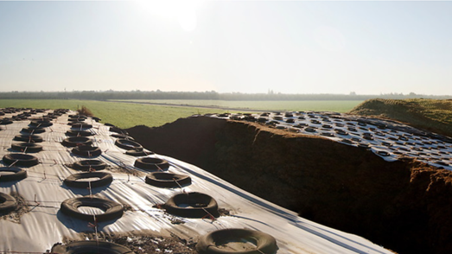
2. Forage Storage
Excluding Oxygen and Water
Oxygen and water are detrimental to fermentation
Achieving a high density helps to minimize oxygen
Utilizing waterproof covers keeps outside sources of moisture away from forage
Notes:
Picture from catalogue Fiscalini_Pan_04.jpg

Slide 25
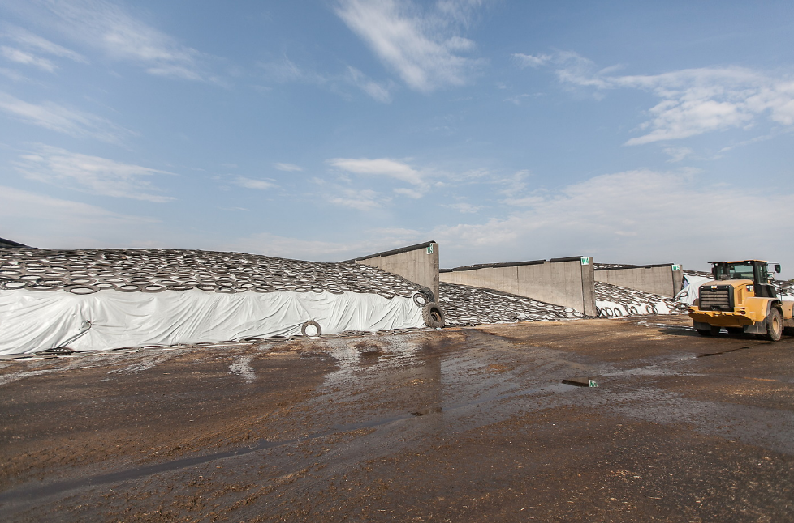
2. Forage Storage
Storage Size
The size of storage must match the needs of the farm
This ensures feed is accessible and bunks are not overfilled
Notes:
https://dairy.photoshelter.com/galleries/C0000.P4WrHK5QIU/G0000ksZ07N98BFg/I0000qDmZSHGaU_8/Crave20-330-jpg

Slide 26
3. Feed Systems and Feedout
Planning
Design appropriately sized feed storage areas
Protect them from the wind, elements, and pests
Utilize bins, bays, commodity sheds, or closed sheds where appropriate
Notes:
Picture from catalogue Crave20 324.jpg

Slide 27
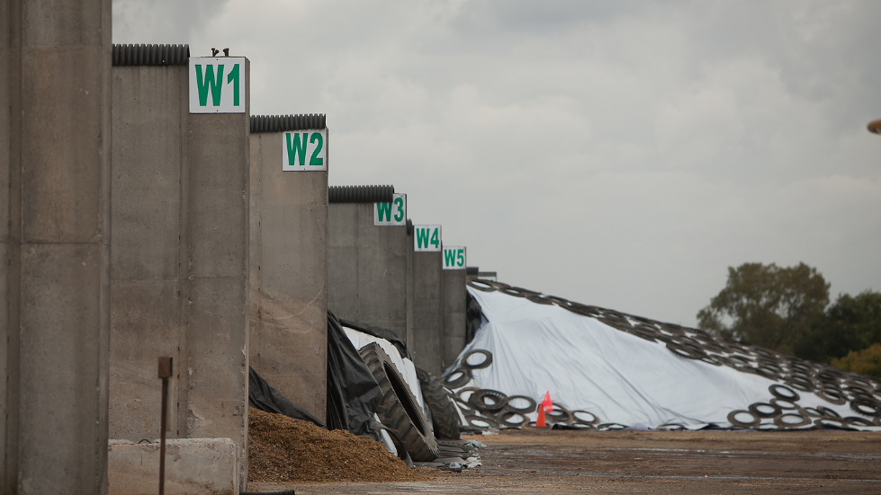
3. Feed Systems and Feedout
Inventory Management
Track inventory and shrink
Weigh all feed as it enters the farm
Losses can be calculated using on-farm feed inventory software
Notes:
https://dairy.photoshelter.com/galleries/C0000.P4WrHK5QIU/G0000ksZ07N98BFg/I0000KvWRy5QNwow/Crave20-512-jpg

Slide 28
3. Feed Systems and Feedout
Maintain and calibrate equipment regularly
Routinely measure the nutrient composition and moisture of forages
Adjust the ration formulation accordingly
Accuracy
Notes:
Picture from catalogue Fiscalini_0536.jpg

Slide 29
3. Feed Systems and Feedout
Optimization
Work with experts to formulate your ration
Monitor dry matter intake
Optimize using home-grown feeds to minimize the need for purchased feed
Notes:
Picture from catalogue Crave20 251.jpg

Slide 30
Conclusion

Slide 31
KEY TAKEAWAYS
Producing feed is a resource-intensive process
Optimizing feed management and minimizing feed loss can reduce dairy farms' environmental footprint
Feed loss or shrink includes a loss of feed quantity and a loss of feed quality
Opportunities exist during harvest, storage, and feedout to reduce feed loss,
preserve feed quality, and improve the sustainability of dairy farms

